Slide 1
Reconnecting the Bayou Darter: A One of its Kind Partnership in the Southeast
August 2024
Sarah McEwen
Senior Project Manager
Sarah.mcewen@neel-schaffer.com

Slide 2
Agenda
Executive Summary
Background data
Design
Criteria
Hydrology
Hydraulics
Design Constraints
Bridge
Fish Passage
Roadway
Detour
Results
Bridge Plans
Fish Passage Plans
Limitations and Improvements
Recent studies

Slide 3
Executive Summary

Slide 4
Executive Summary
The Mississippi Department of Transportation (MDOT) selected the State Route 18 stream crossing of White Oak Tributary 1 for replacement based on the need to widen the road to support requirements for evacuation routes and the future Average Daily Traffic count.
The site is north of Port Gibson, and north of the Bayou Pierre crossing along SR 18.
The existing crossing was a double box culvert design that was installed in 1935 with a drainage area of roughly 2 square miles.
At first glance this seems to be a simple alternative analysis to determine if widening the culverts or a bridge is required; however, the environmental investigation led to a unique partnership with the United States Fish and Wildlife because the crossing sits in the Bayou Pierre Watershed, the only place on earth you find the threatened Bayou Darter (Etheostoma rubrum).
Notes:
Let class discuss

Slide 5
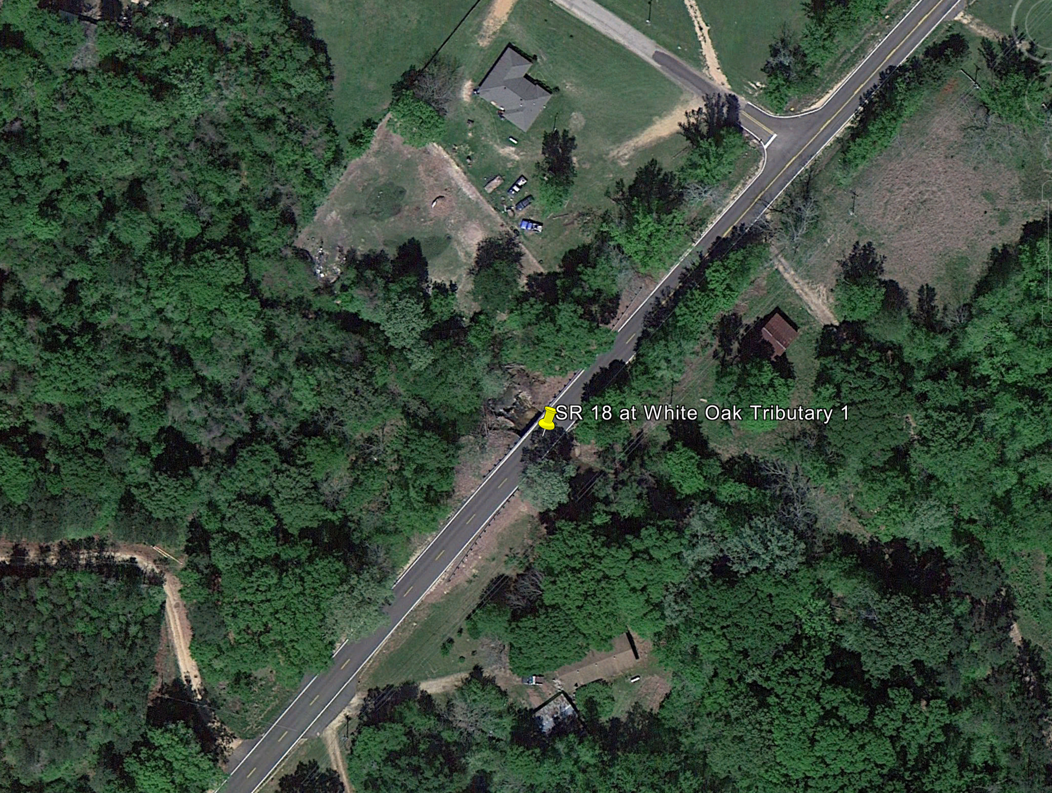
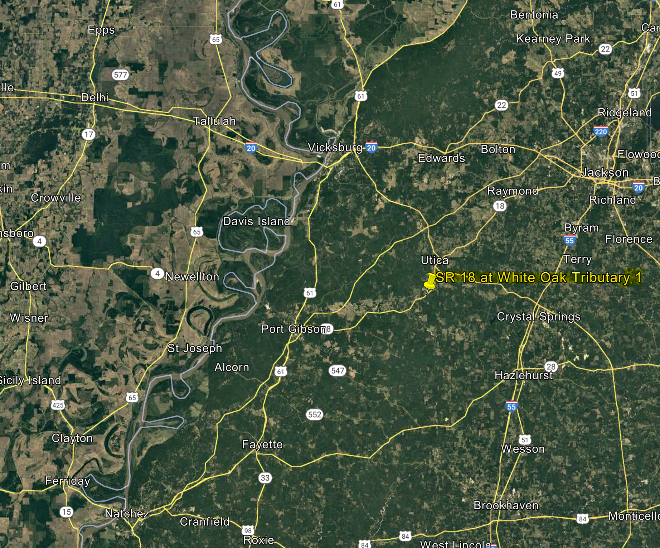
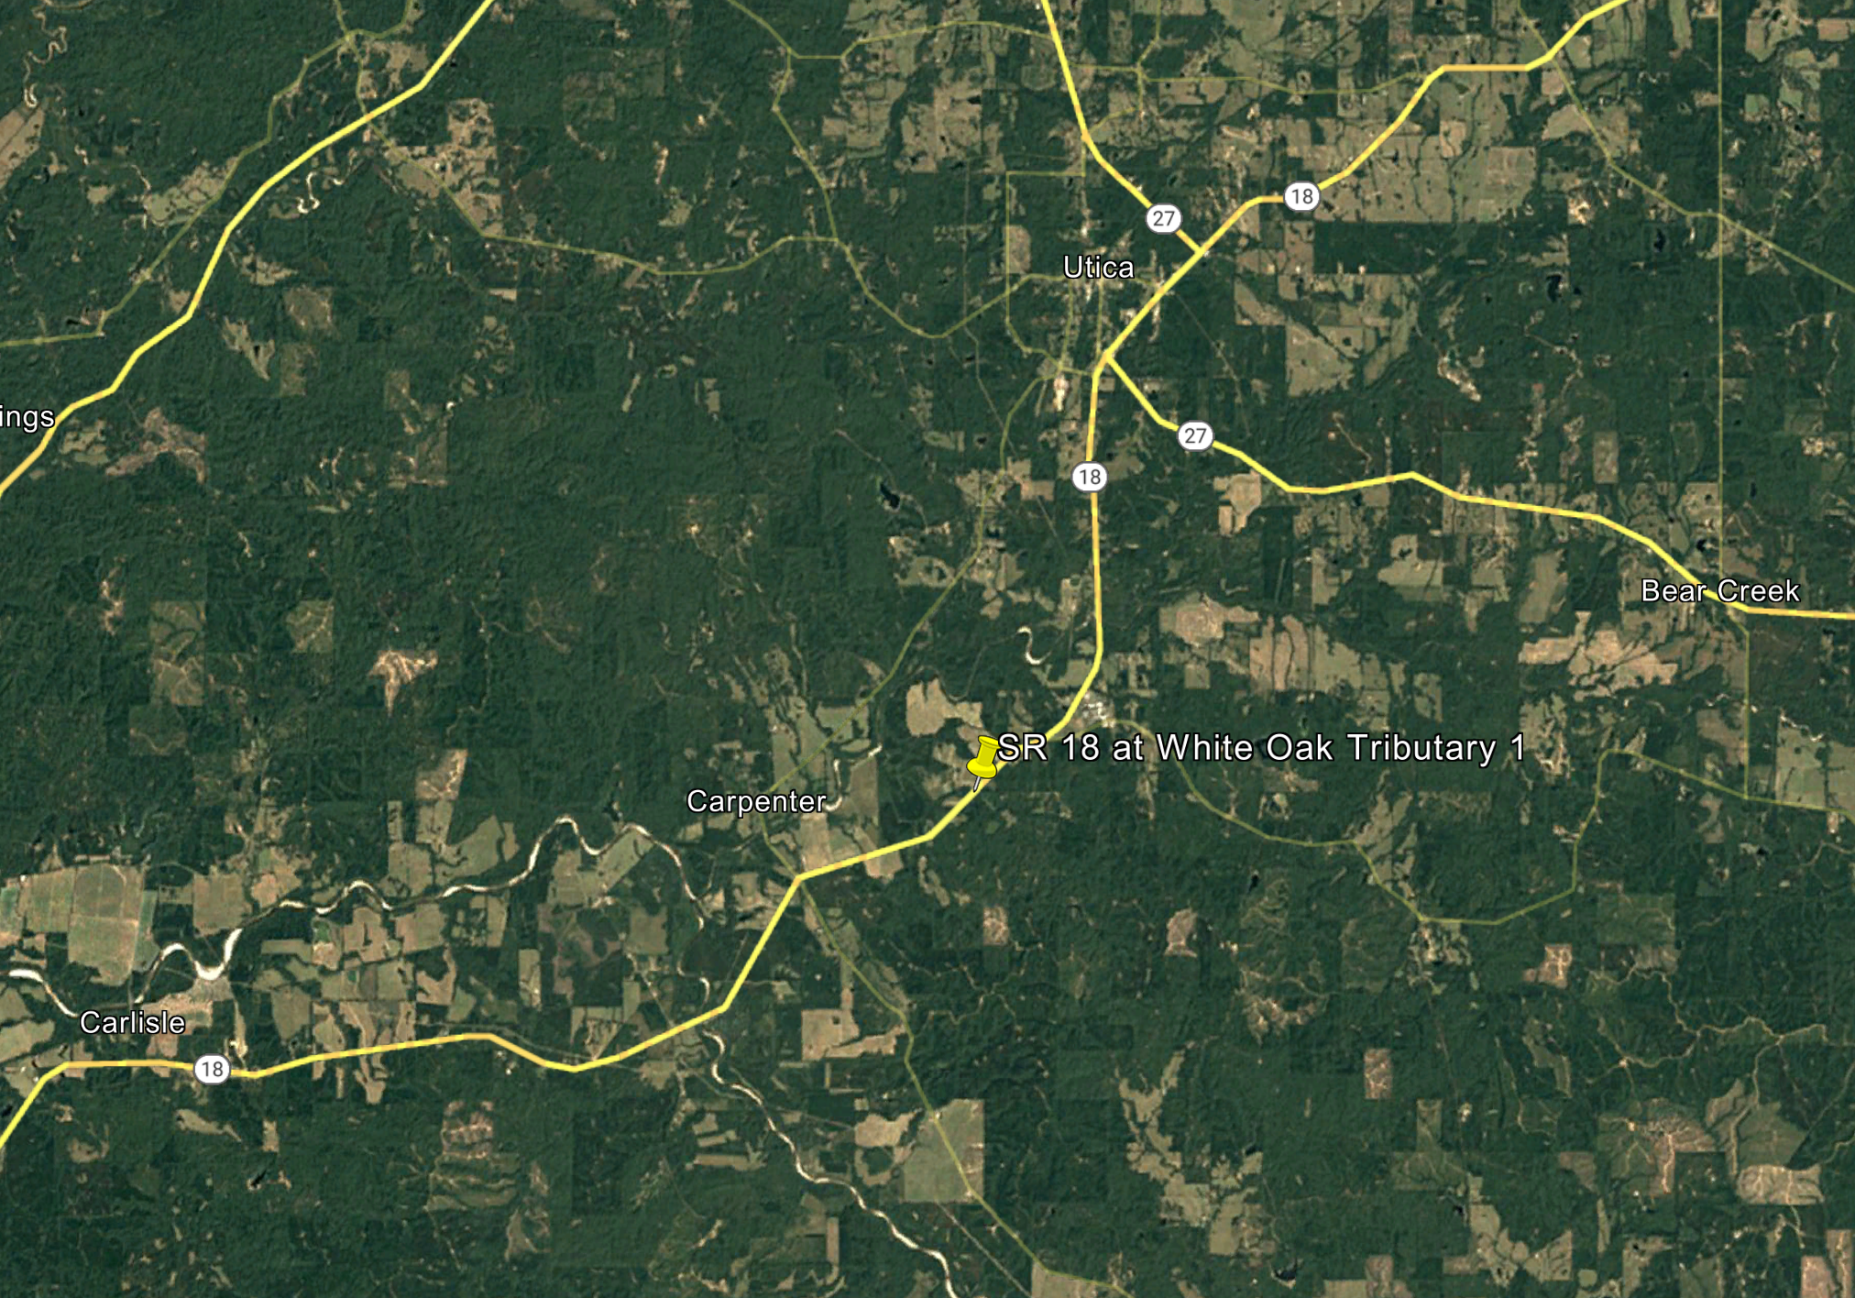
Executive Summary
Notes:
Let class discuss

Slide 6
Executive Summary
Erosion and high water for larger recurrence events created headcuts and steep riverbanks within the Bayou Pierre watershed which damaged Bayou Darter spawning habitat.
These problems were compounded by decades of poor management decisions related to gravel mining and livestock raising along the river.
This site, because of an existing ten-foot headcut at the outfall of the culvert, was selected for redesign and replacement including aquatic organism passage due to it being critical habitat for a threatened species and the individual needs of the species.
Notes:
Let class discuss

Slide 7
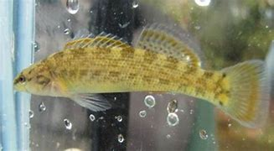
Executive Summary
In this presentation we will walk through the partnership of the state and federal agencies, the design process and evaluation of the site, and show the final design with finished construction of the first step-pool fish passage in the Southeast.
Image courtesy of US Fish and Wildlife Service.
Notes:
Let class discuss

Slide 8
Background Data

Slide 9
Background Data
Site Conditions/Inspection Reports
Terrain
Land Use
Soil
Aerial Imagery

Slide 10
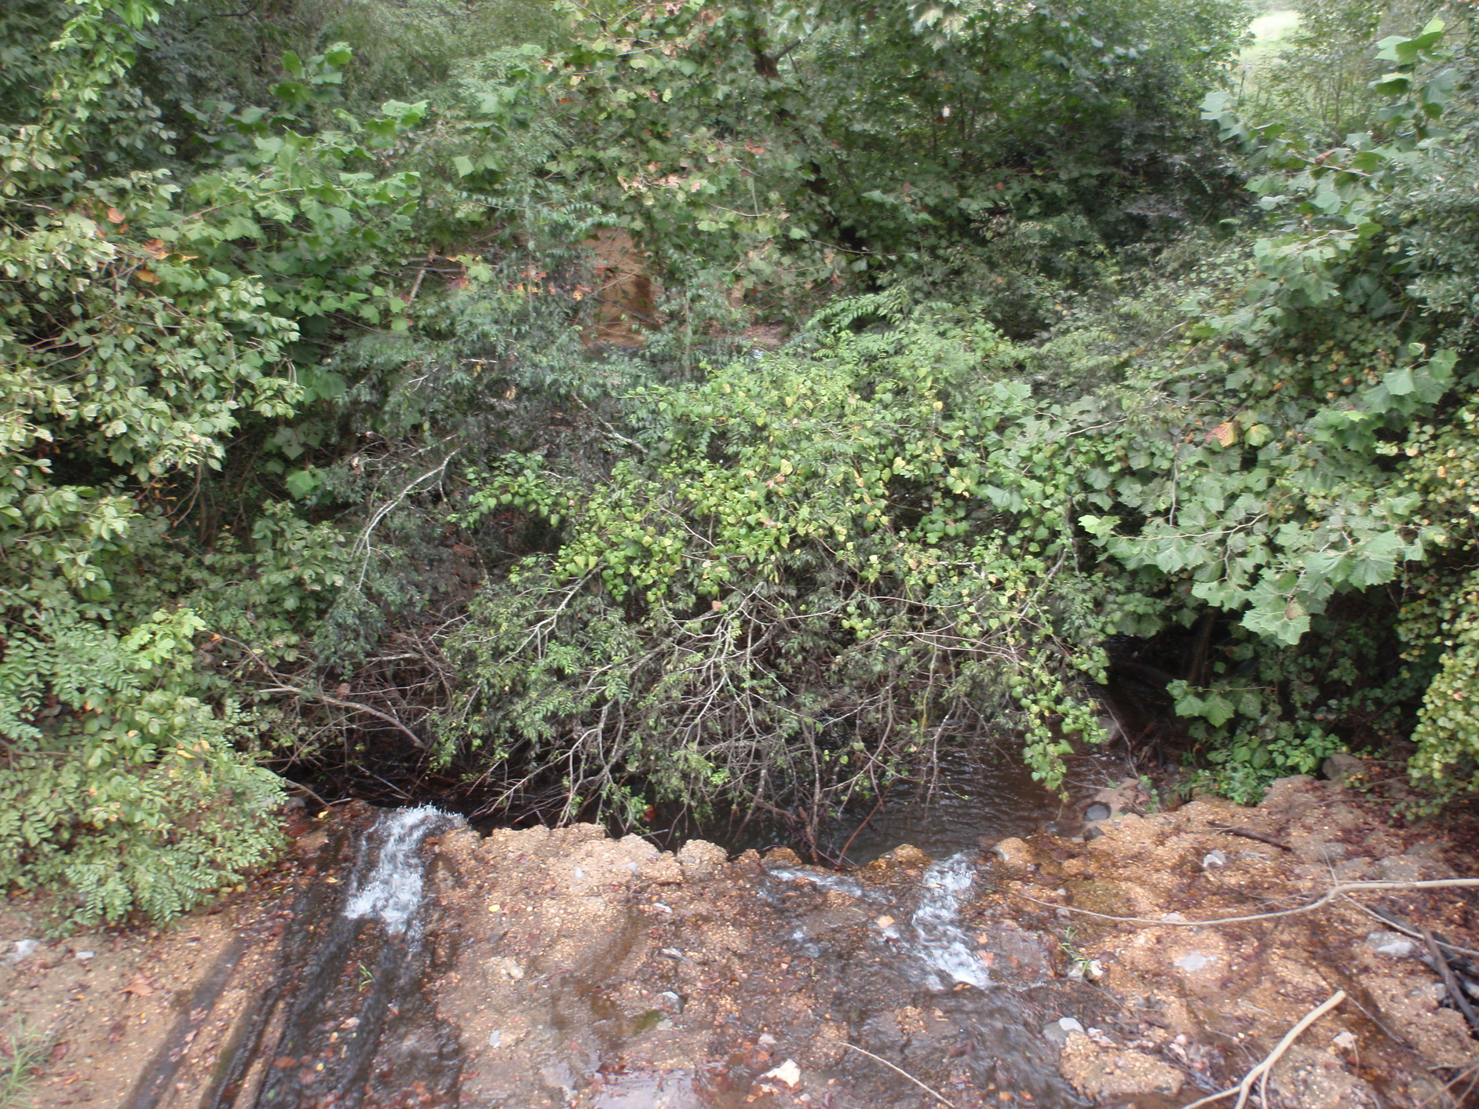
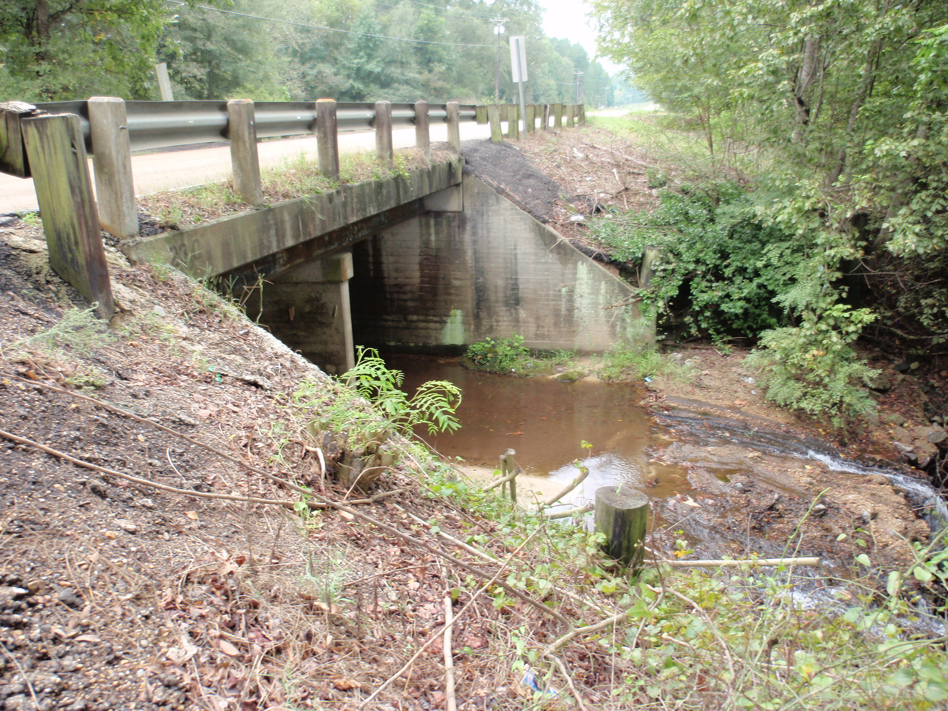
Site Conditions
Site Conditions/Inspection Reports
Looking Downstream from Culvert Apron
Culvert Downstream Face 2009

Slide 11
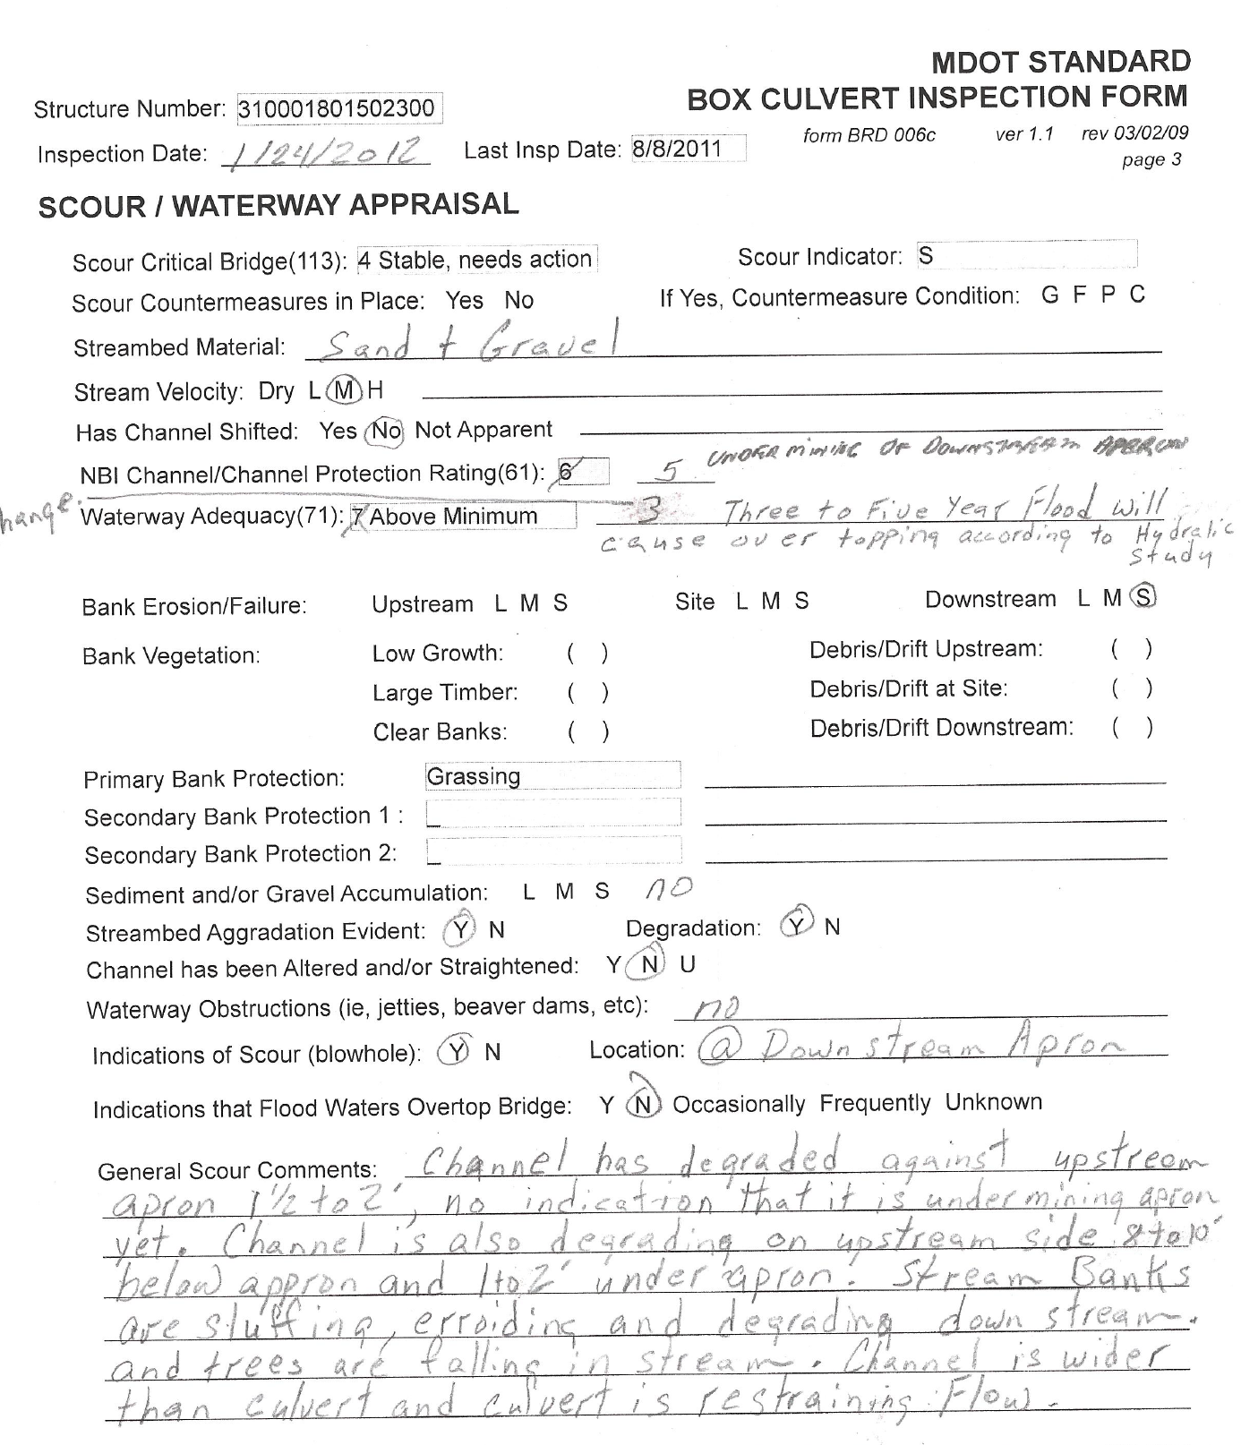
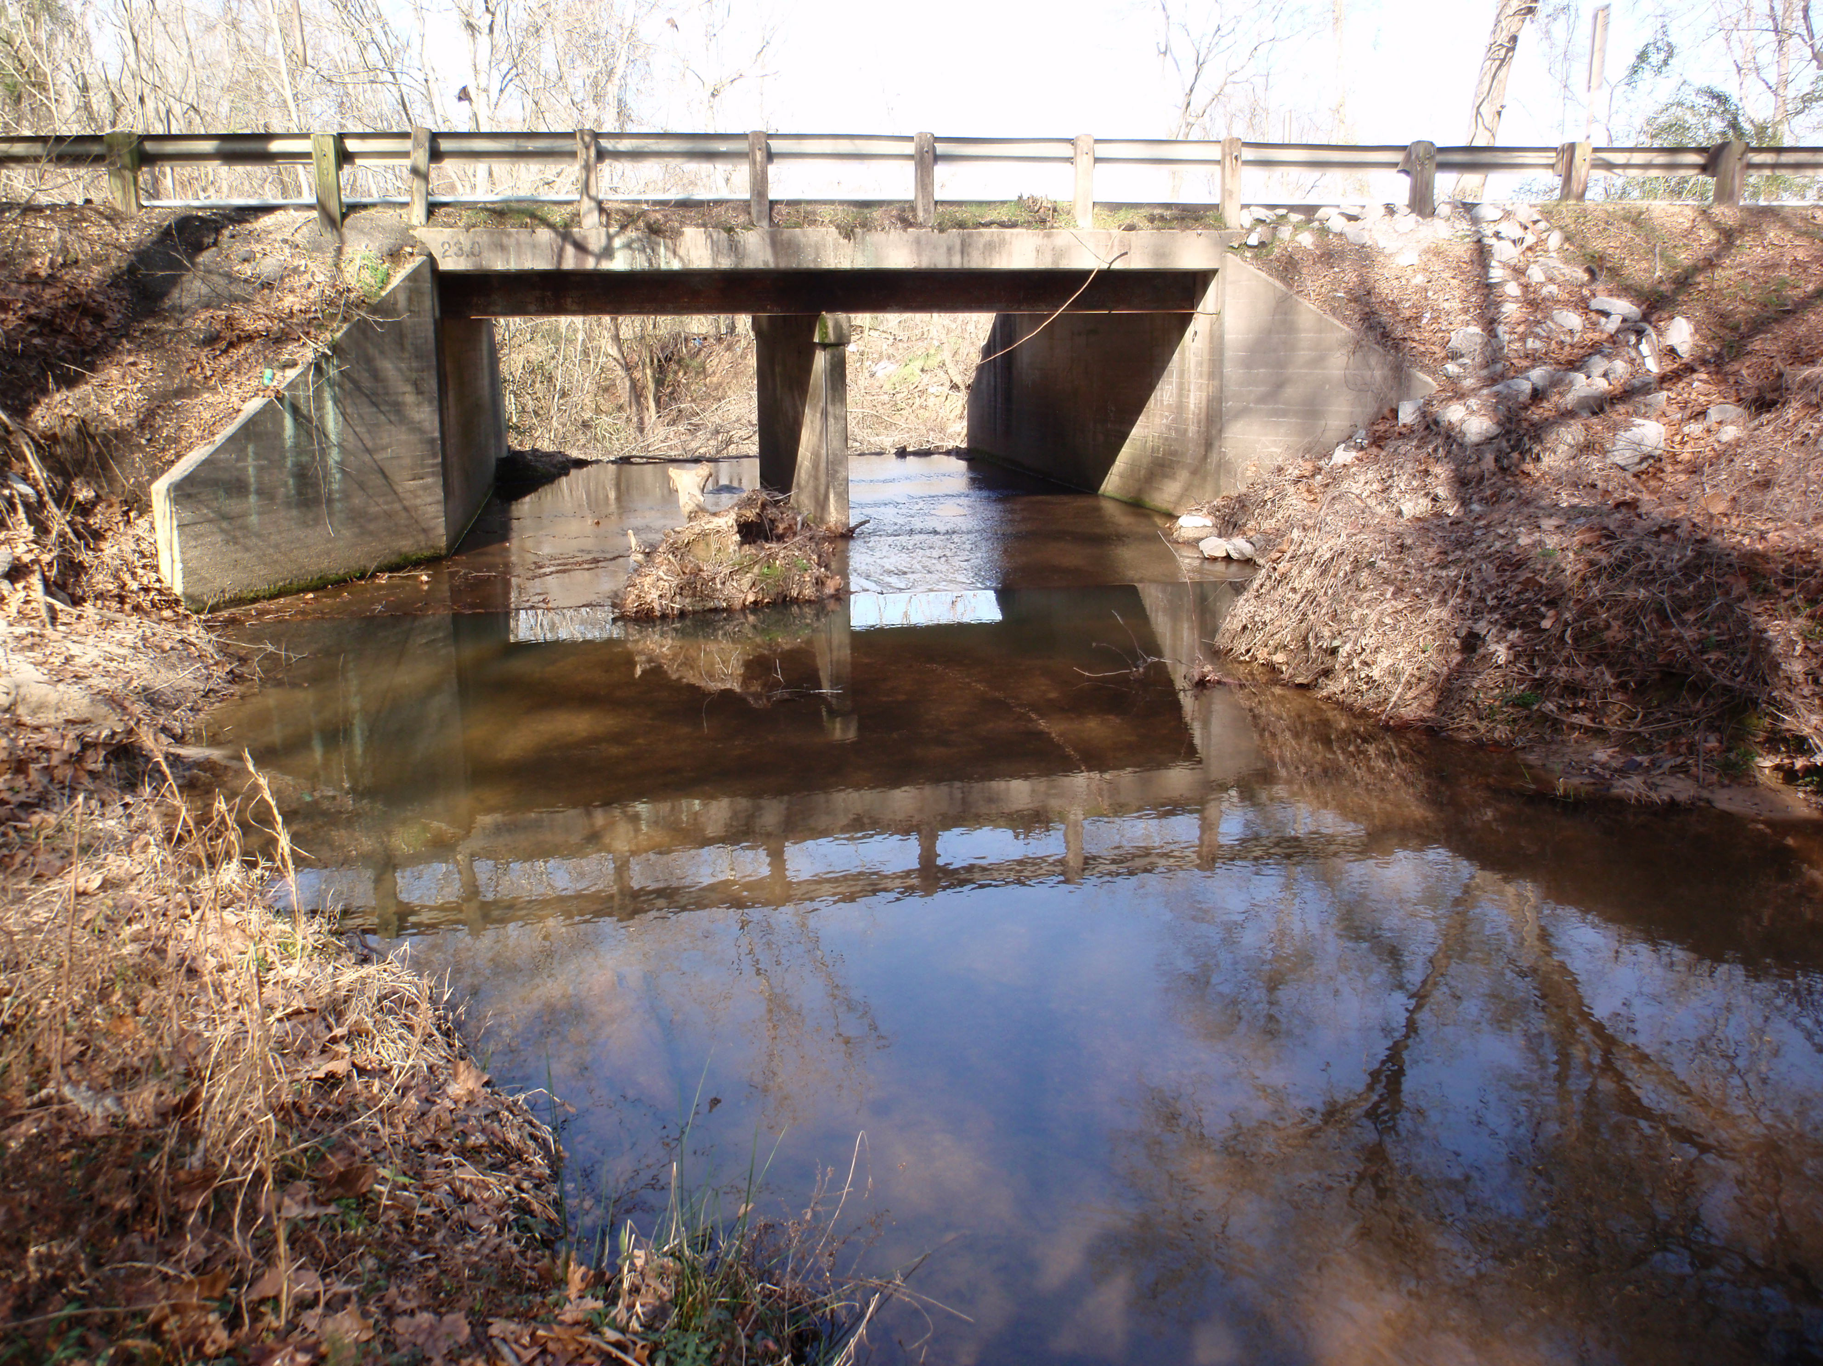
Site Conditions
Site Conditions/Inspection Reports
Culvert Upstream Face 2012

Slide 12
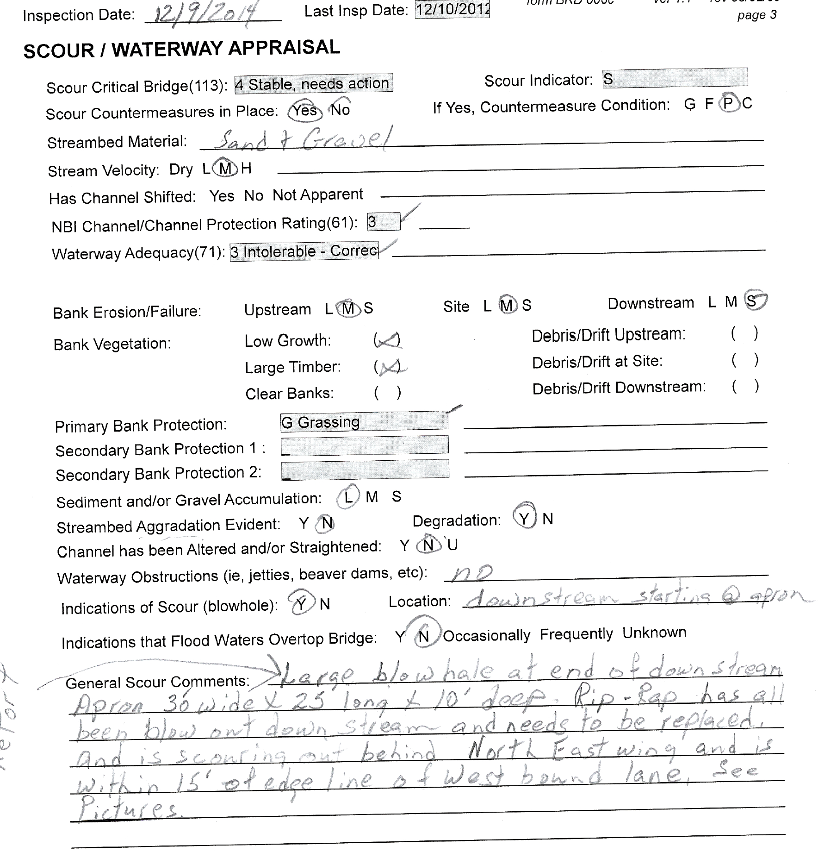
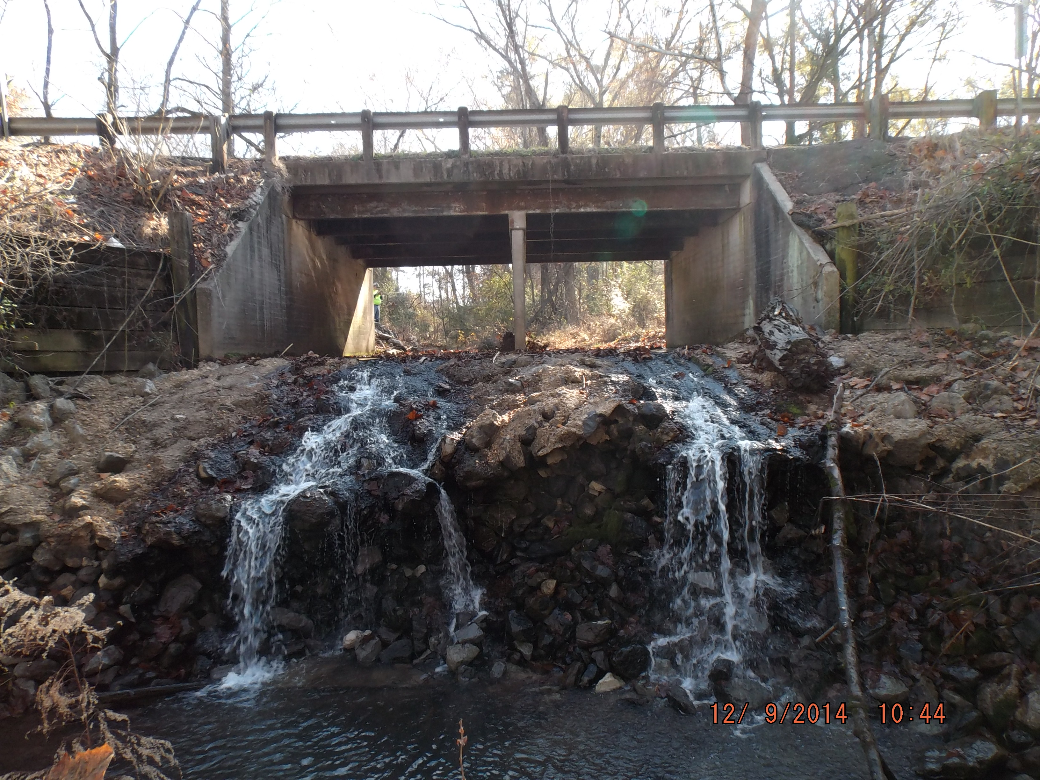
Site Conditions
Site Conditions/Inspection Reports
Culvert Downstream Face 2014

Slide 13
Terrain
To support analysis, LiDAR was used collected by the state program Mississippi Digital Elevation Model (MDEM) available on Mississippi Automated Resource Information System (MARIS).
This terrain data was supplemented by MDOT collected hydraulic survey which typically includes a channel profile, floodplain cross sections, and structural/roadway surveys.

Slide 14
Design

Slide 15
Design
Design
The project included several alternatives, but each had to meet clear design standards, pass the design recurrence events for MDOT with respect to required freeboard, resolve the head cut, and allow passage of the Bayou Darter during low flow events with respect to its biological limitations.
Design Criteria
Hydrology
Hydraulics
Design Constraints

Slide 16
Phase A Bridge Hydraulics-Design Criteria
MDOT Phase A bridge recommendations start with some general design criteria
RWD 600 Form lists proposed width, alignment, if detour is required, expected ADT, and notes from the Location Committee Meeting (LCM)
MDOT hydraulics requires that:
“To determine the design event, MDOT uses a risk-based approach based on the functional class of the roadway. The minimum design freeboard elevation is 2’ above the design event or 1’ above the 100-year event, whichever is greater.”
For this project, the design event was the 50-year event.
The 50-year +2’ controlled.
Span arrangements should be considered for hydraulic requirements but also preventative maintenance, constructability, and durability.

Slide 17
Hydrology
Several methods are allowed for hydrology depending on the nature of the watershed, the area of the drainage contributing to the site, and urbanization.
For MDOT, usually the local USGS department is requested to issue a report on the nature of the hydrology. This includes recurrence event flows and expected stages developed from the floodplain survey.
The data for this comes from USGS 1991 Regional Regression equation and reports out of that office.
The snip below shows the flow relationship for this site as provided by the DOT.
Notes:
verified the usgs report manually using 1991 regression and then a comparison to todays regression with streamstats

Slide 18
Hydraulics
2013-
HEC-RAS 1D was the preferred and specified model for MDOT
1D cross sections spaced in alignment with the HEC-RAS Manual
Plans
Existing Conditions with Culvert in Place
Proposed Conditions with the Proposed Structural alternatives culvert and bridge during initial phases
Natural conditions as if the roadway embankment wasn’t in place
Flows
Same flows for all plans 2 year-500 year recurrence range
Geometries
A geometry file for each plan and alternative with changes being specific to the structural alternatives and the fish passage system combined
Notes:
Let class discuss

Slide 19
Design Constraints
Design Constraints
Bridge
Needs to meet hydraulic opening criteria for design 50-year event and check event 100-year
Needs to meet freeboard requirements 50 year WSEL +2’ for low chord, 100-year WSEL+1’ for low chord
Should consider having main span setback from channel banks 15’ if lateral migration or bank stability are concerns
Fish Passage
Needs to meet biological constraints of Bayou Darter
Roadway
Needs to minimally impact grade and be evaluated for updated roadway design criteria on alignment, clear zones, embankment slopes, roadway hydraulics and consider ROW impacts
Detour
Needs to be designed to pass 5-year event for during conditions
Notes:
Let class discuss

Slide 20
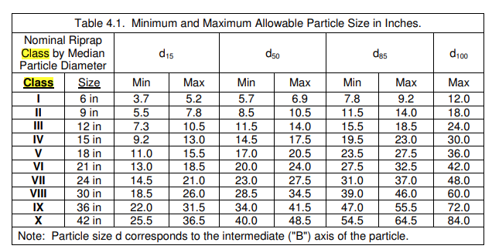
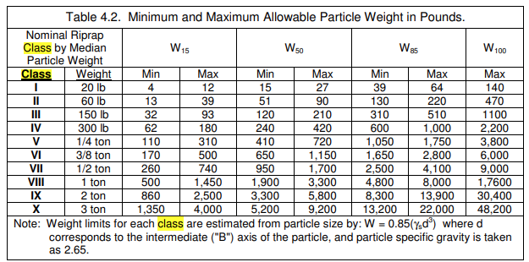
Revetment
We used the FHWA Hydraulic Engineering Circular 23 Design Guide 4 to size the riprap. The placement required geotextile to be placed underneath.
HEC 23 Volume II Bridge Scour and Stream Instability Countermeasures: Experience, Selection, and Design Guidance-Third Edition (dot.gov)
In general with this method, we designed the riprap to meet the higher flow velocities and depth taken from the 50-year and 100-year events, with the minimum thickness being 1.5*D50 or D100 whichever is greater. Per MDOT, if calculations show that the design size of rock is less than 300 lb., 300 lb. rock should still be recommended unless approved by the State Hydraulics Engineer.
The DG 4 has guidance on the equations to determine the D50, and from there guidance tables on class and weight.

Slide 21
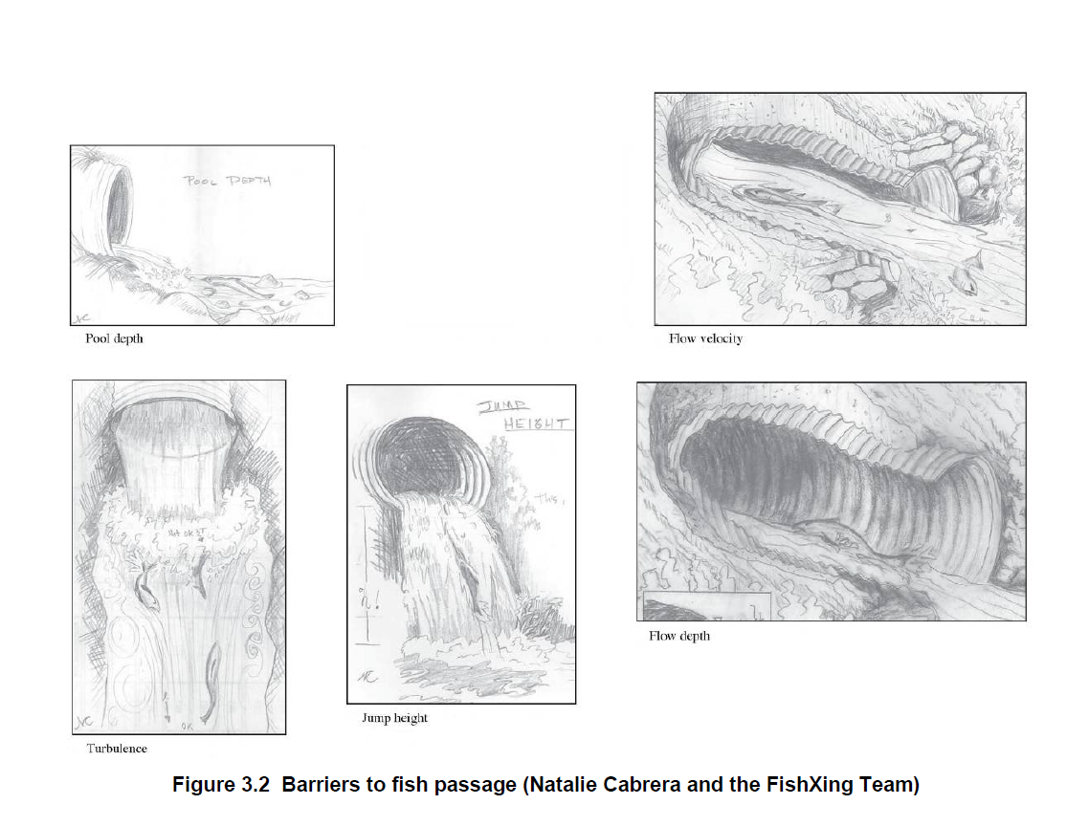
Fish Passage
Fish Passage why remove the culvert?
Besides undermining and apparent undersized nature of the crossing, culverts can become inhibitors to fish passage when they exceed the fish’s biological capacity through velocity, turbulence, drops, and depths
Notes:
Let class discuss

Slide 22
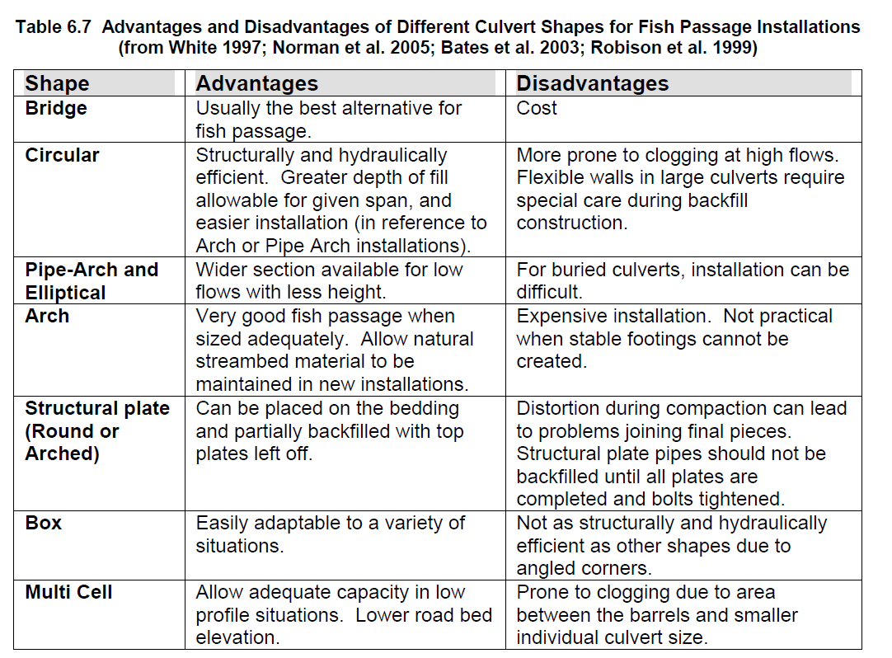
Fish Passage
Questions to ask when looking at a fish passage to inform design:
What are the target species?
What are the seasonal needs of the fish?
What is the biological capacity and size of the fish?
At what flows, and time periods are these fish migrating? What is the allowable delay?
Depending on the length of the culvert is lighting required?
Culvert Length and Interior Lighting Impacts to Topeka Shiner Passage (mndot.gov)
Notes:
Let class discuss

Slide 23
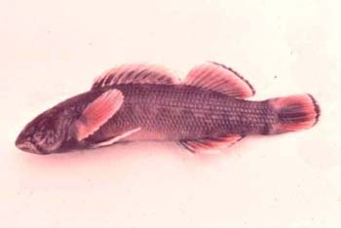
Bayou Darter
The Bayou darter is only found in the Bayou Pierre Watershed. It generally lives and requires swift shallow riffles over gravel and pebbles. The extent and quality of habitat appear to be related to headcutting.
Darter habitat is potentially threatened by gravel mining, clearing of riparian vegetation with subsequent cultivation to the riverbank, road and bridge construction and transmission line construction and maintenance.
[1] U.S. Fish and Wildlife Service. 1990. Bayou Darter Recovery Plan. U.S. Fish and Wildlife Service, Jackson, Mississippi. 25pp.
[2] Ross, S. T., M. T. O'Connell, D. M. Patrick, C. A. Latorre, W. T. Slack, J. G. Knight, and S. D. Wilkins. 2001. Stream erosion and densities of Etheostoma rubrum (Percidae) and associated riffle-inhabiting fishes: biotic stability in a variable habitat. Copeia 2001:916-927
Notes:
Let class discuss

Slide 24
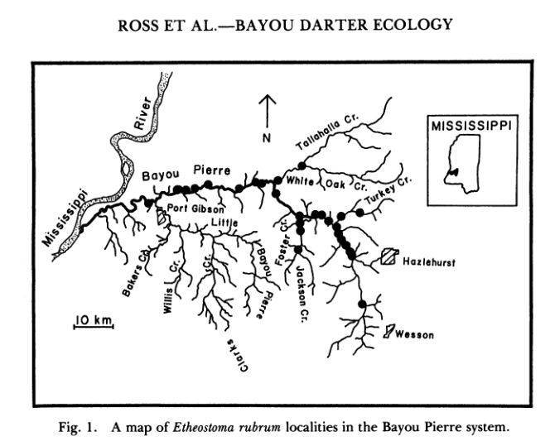
Bayou Darter
The U.S. Fish and Wildlife Service, Jackson, Mississippi was engaged during the Phase A Bridge Design process to support and advise on the biological constraints of the Bayou Darter and review the proposed in channel alternatives.
They provided research into:
Typical fish size based on maturity (Age 1 average size 27 mm)
Spawning season (April-August)
Typical habitat swift shallow water (75 cm/sec (2.46 ft/s))
Location distribution
Fish survey
Notes:
Let class discuss

Slide 25
Results

Slide 26
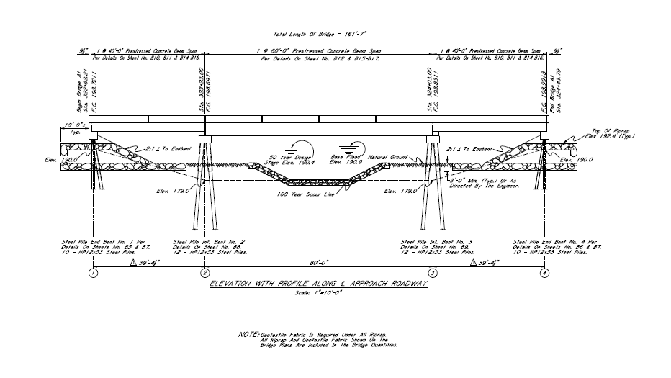
Bridge Design
Why a multi span bridge?
A single bridge while easier to maintain without joints or piers would have had a larger beam depth, than the multi-span, which increases the grade impact. The single beam is also more expensive because of special transportation and fabrication cost. At some point there is a break between cost benefit of the single beam.
A multi-span allowed for a smaller beam depth, met the hydraulic opening requirements and still fit the channel design.
Note: This was before FIB became frequently used and were an option.

Slide 27
Bridge Design

Slide 28
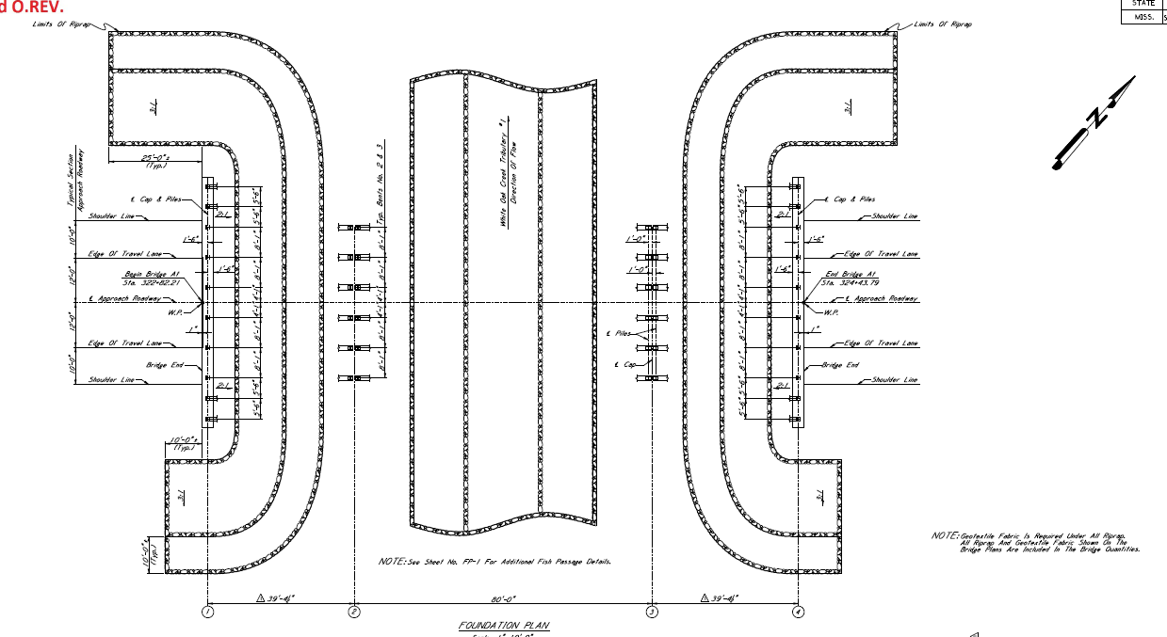
Bridge Design

Slide 29
Channel Design
Why a step-pool?
A rock chute is a more typical grade remediation method for contractors in the area, how ever it created shallow fast conditions that would exceed the capacity of the darter and could have been undermined by future headcutting.
A step-pool system, was evaluated for the grade change needed, overall ROW limits for the length of the channel design, and unit discharge capacity of the Bayou Darter at 2-year flows to create a pool system that should operate during low flow events. The idea being that the 2-year would have shallow flow, but lower events could hold the delay within the pools.
This does not mean that larger flows wouldn’t move the darter downstream as it naturally occurs at unimpeded crossing, but just that the crossing would meet as many of the design criteria to support upstream movement.

Slide 30
Channel Design

Slide 31
Channel Design

Slide 32
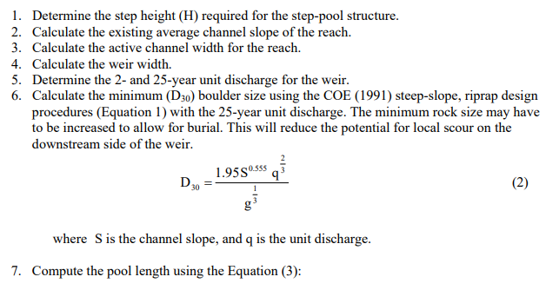
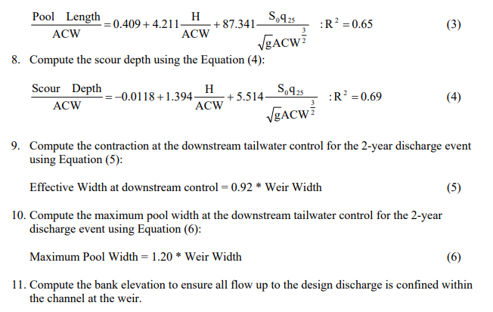
Channel Design
How to design a step-pool?
Design based on A Design Procedure for Sizing Step-Pool Structures D.B. Thomas (1), S.R. Abt (2), R.A. Mussetter (1), M.D. Harvey (1)

Slide 33
Channel Design
How to design a step-pool?
5 pools total
2- Phased construction
2- foot depth in pool created by grading and rock checks
Riprapped and stable channel
Informed and modified by USFWS
Informed and modified by MDOT and practical construction practices of the district
HEC-RAS 1D used to evaluated and iterate the design to meet the guidance and check the velocities, unit discharge, and overall criteria met.

Slide 34
Limitations and Improvements

Slide 35
Limitations
If I had to do this project again, what would I change?
If done today, I would use a 2D model. At the time 2D was not as frequently used and it along with a sediment transport model might have led to a more natural design in lieu of the hardened design. Although as the channel ran under a piece of critical infrastructure the revetment method might still have been an alternative to review and consider.
If done today a single span bridge with new beam types might have made more sense and then opened the door to a more natural channel meander or design.
If done today, further tracking and documenting of the result and if it was successful for the migration of the fish.

Slide 36
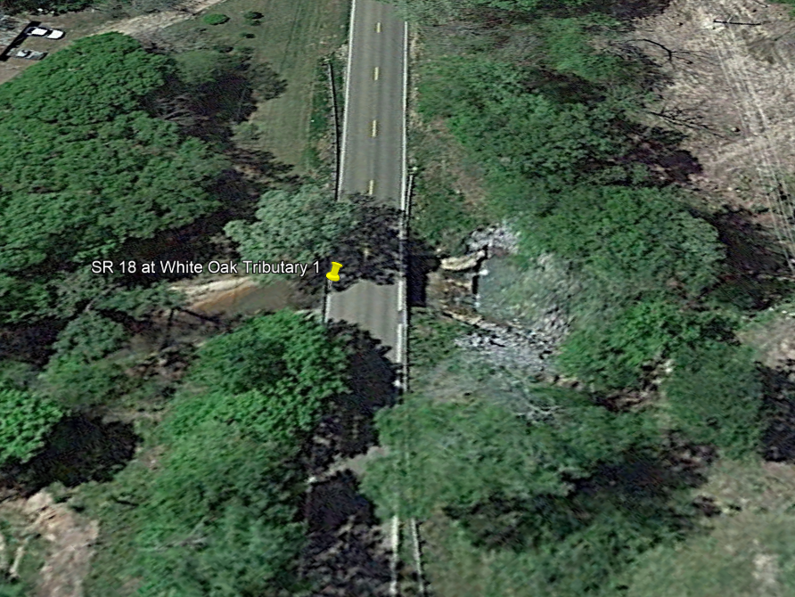
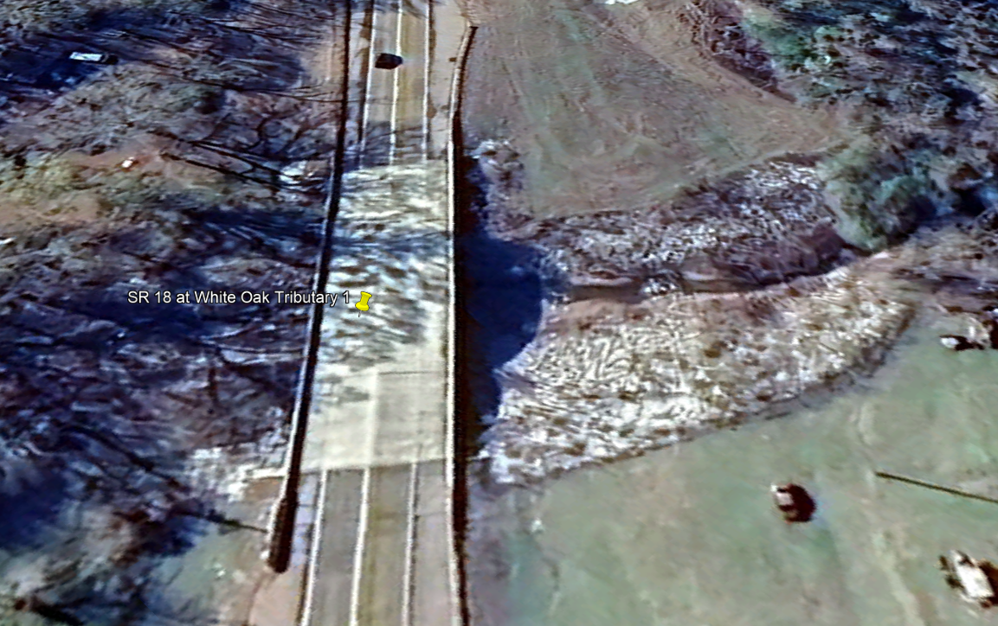
The Site Today
2016 2024

Slide 37
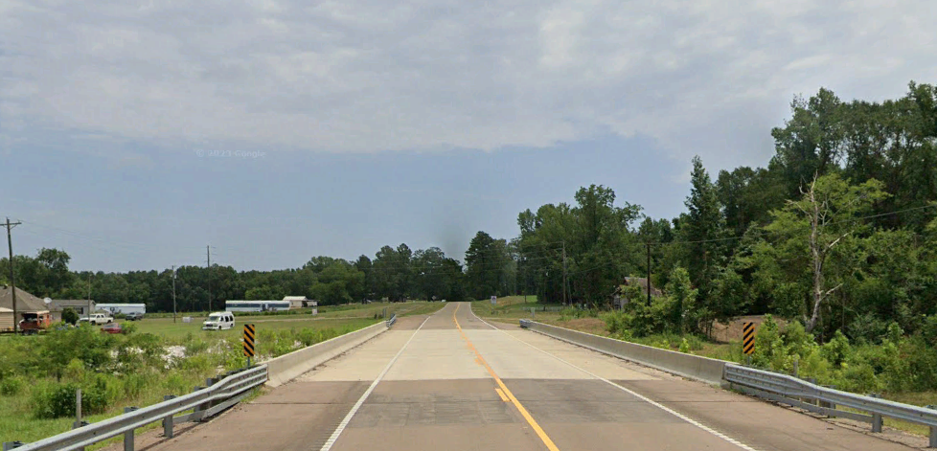
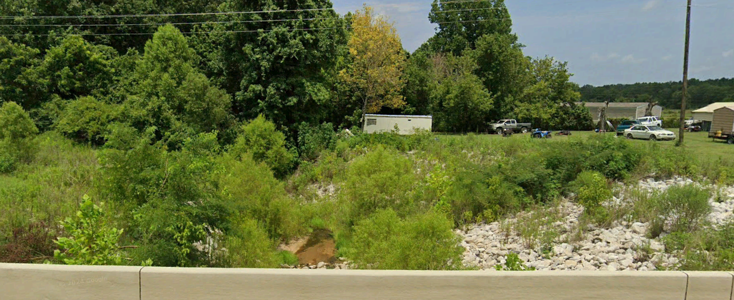
The Site Today

Slide 38
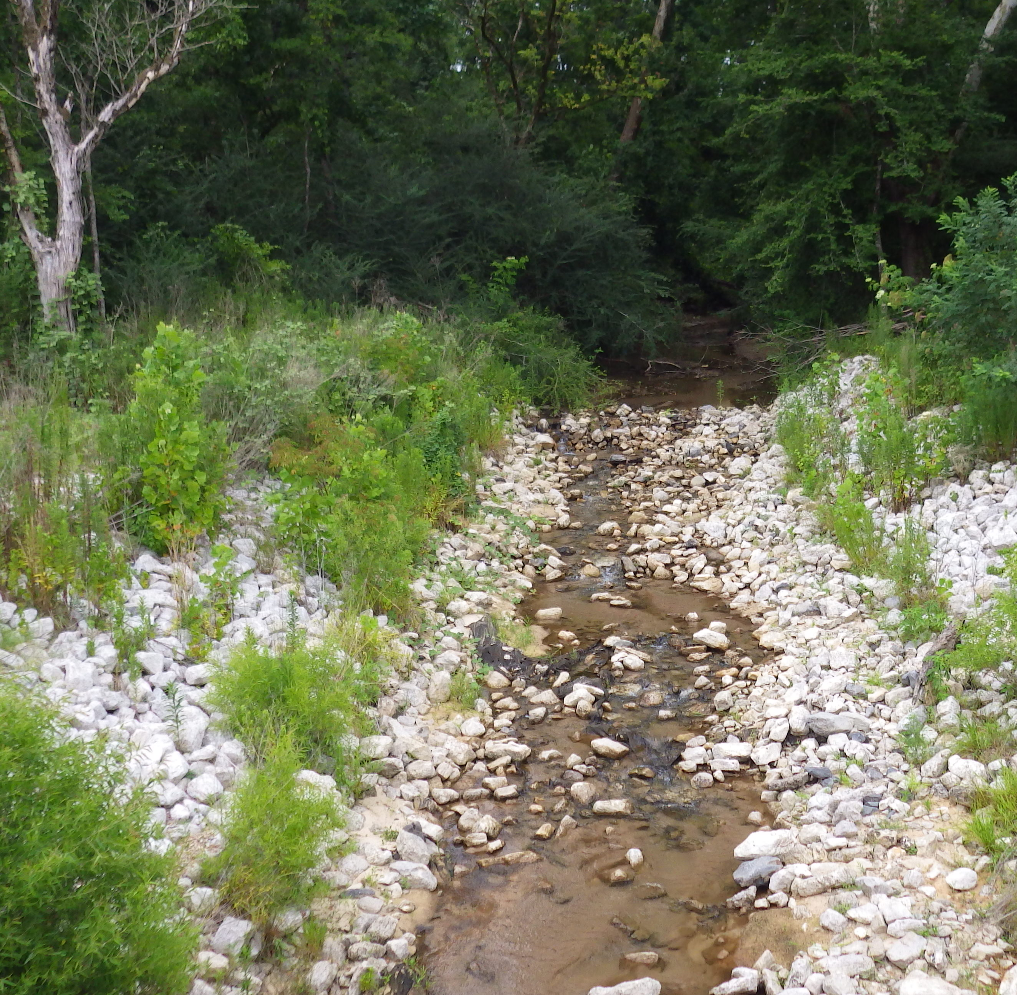
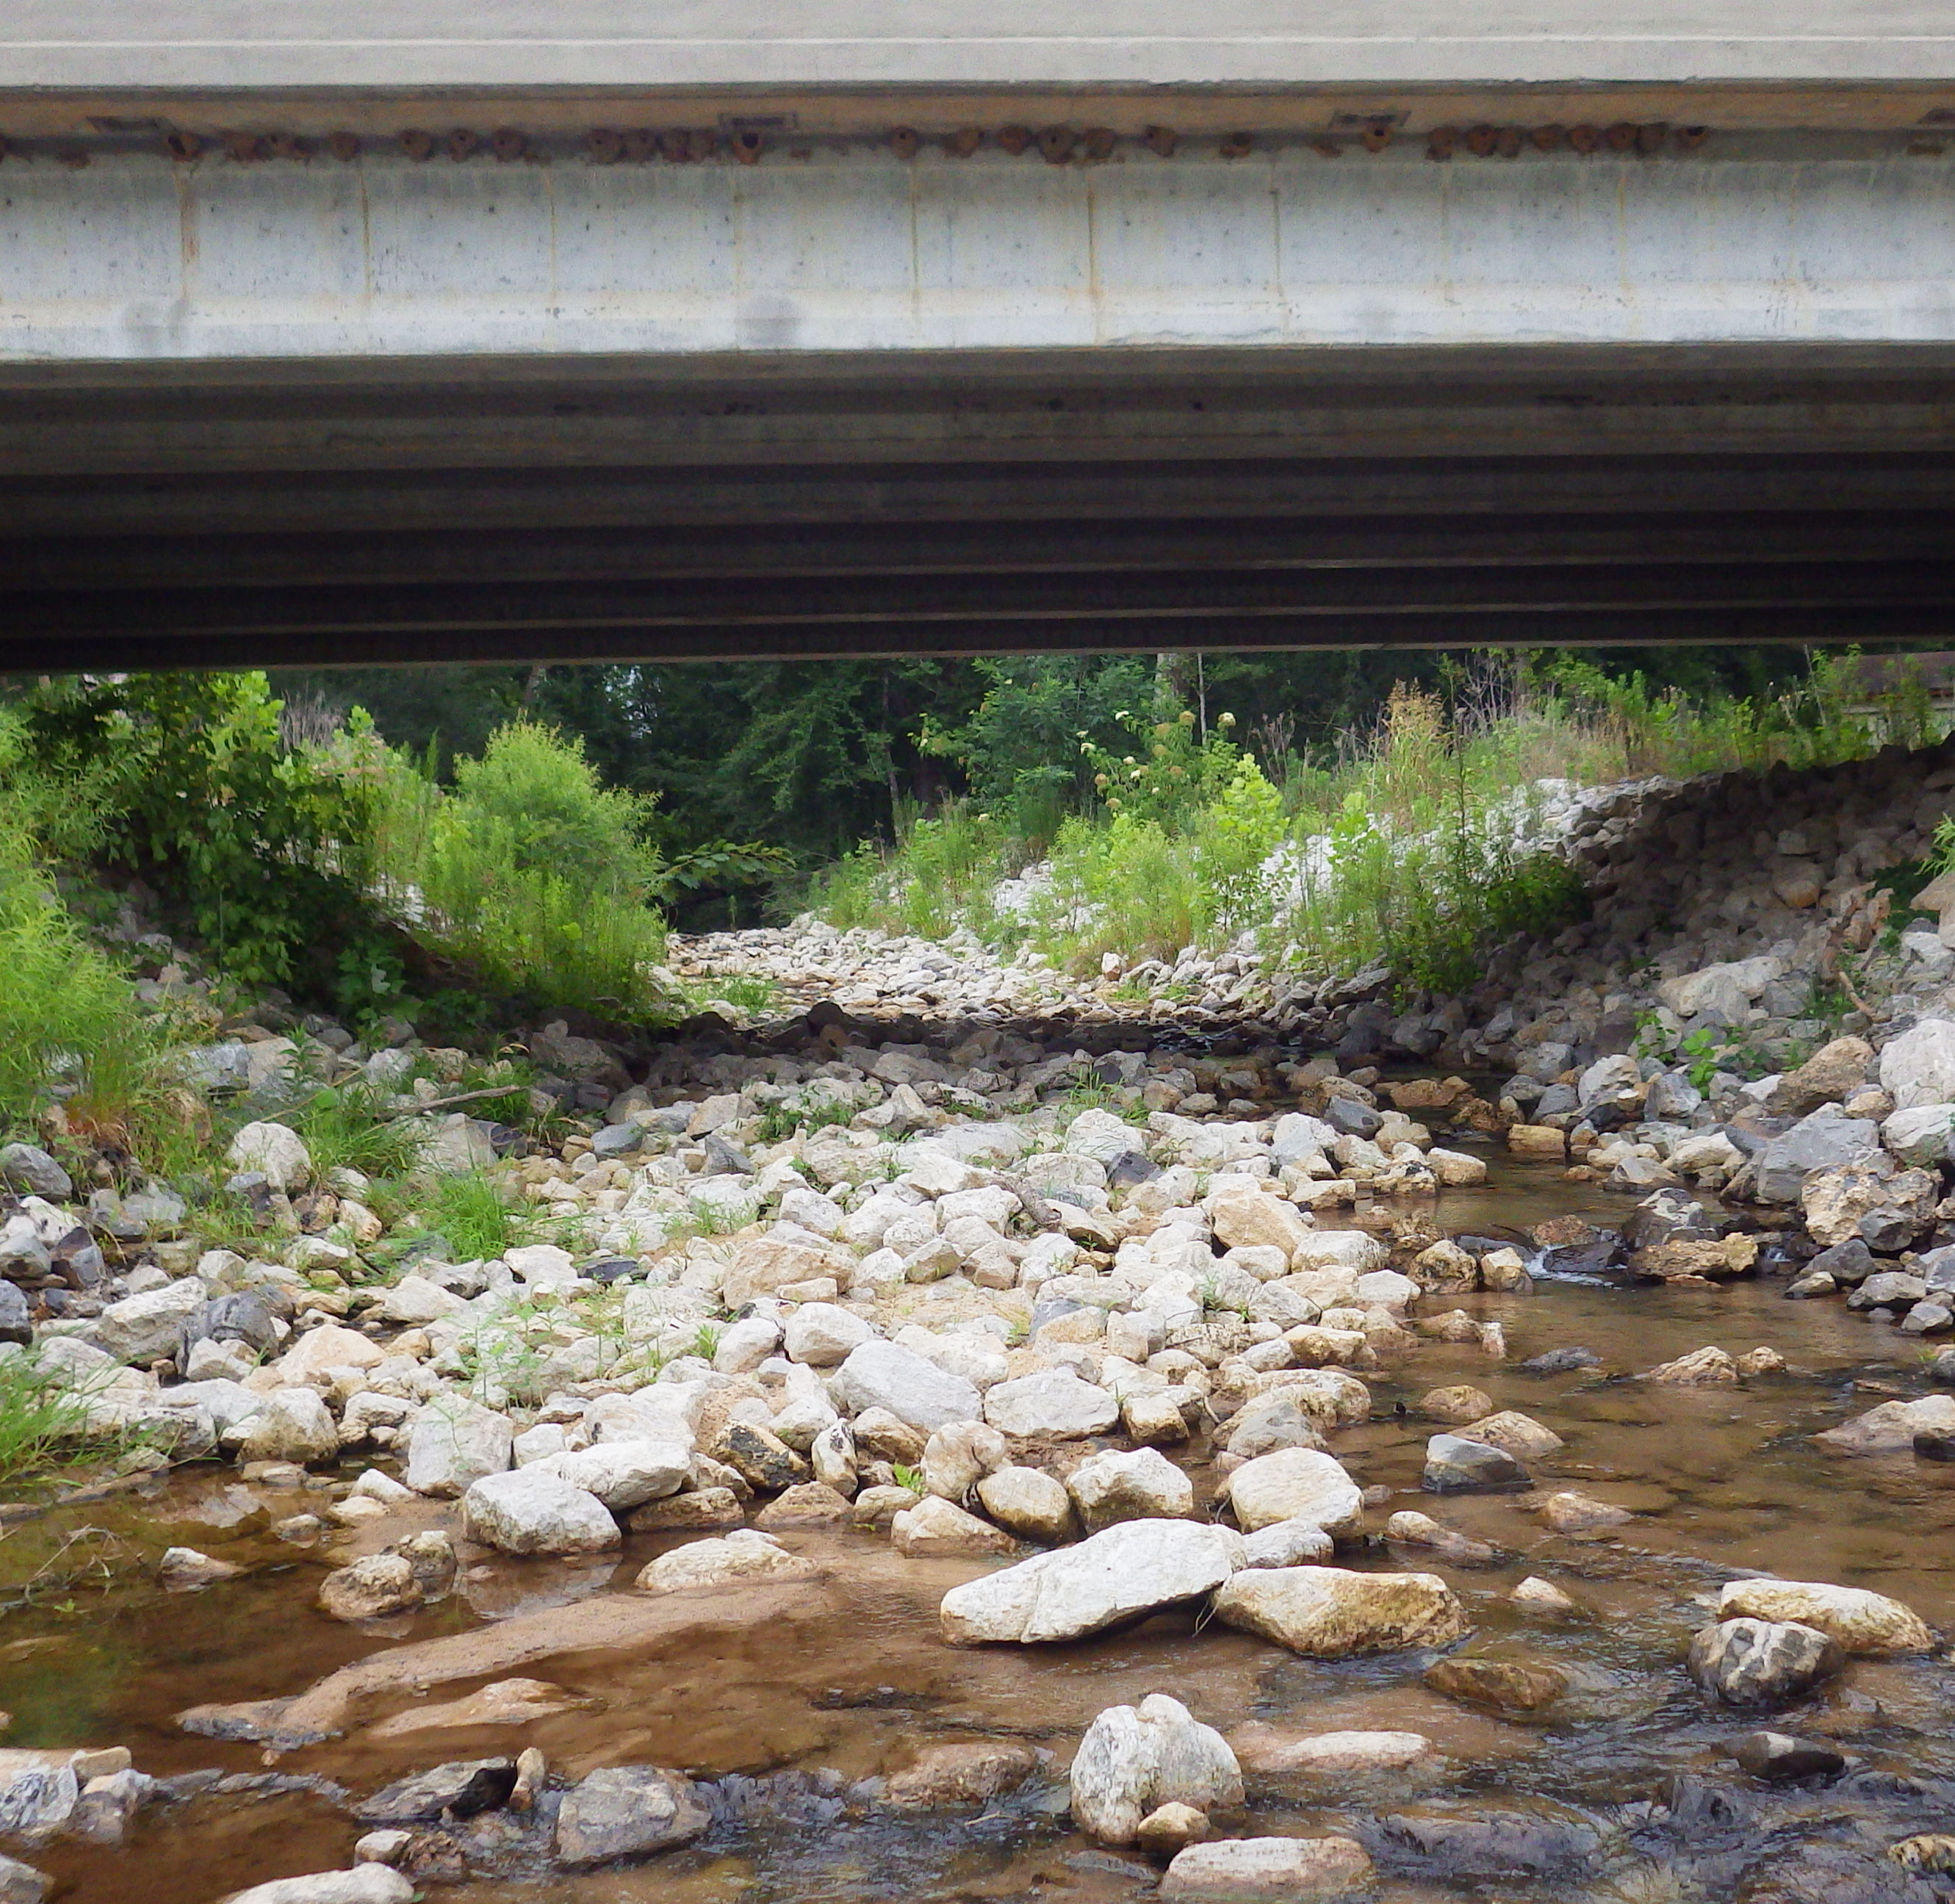
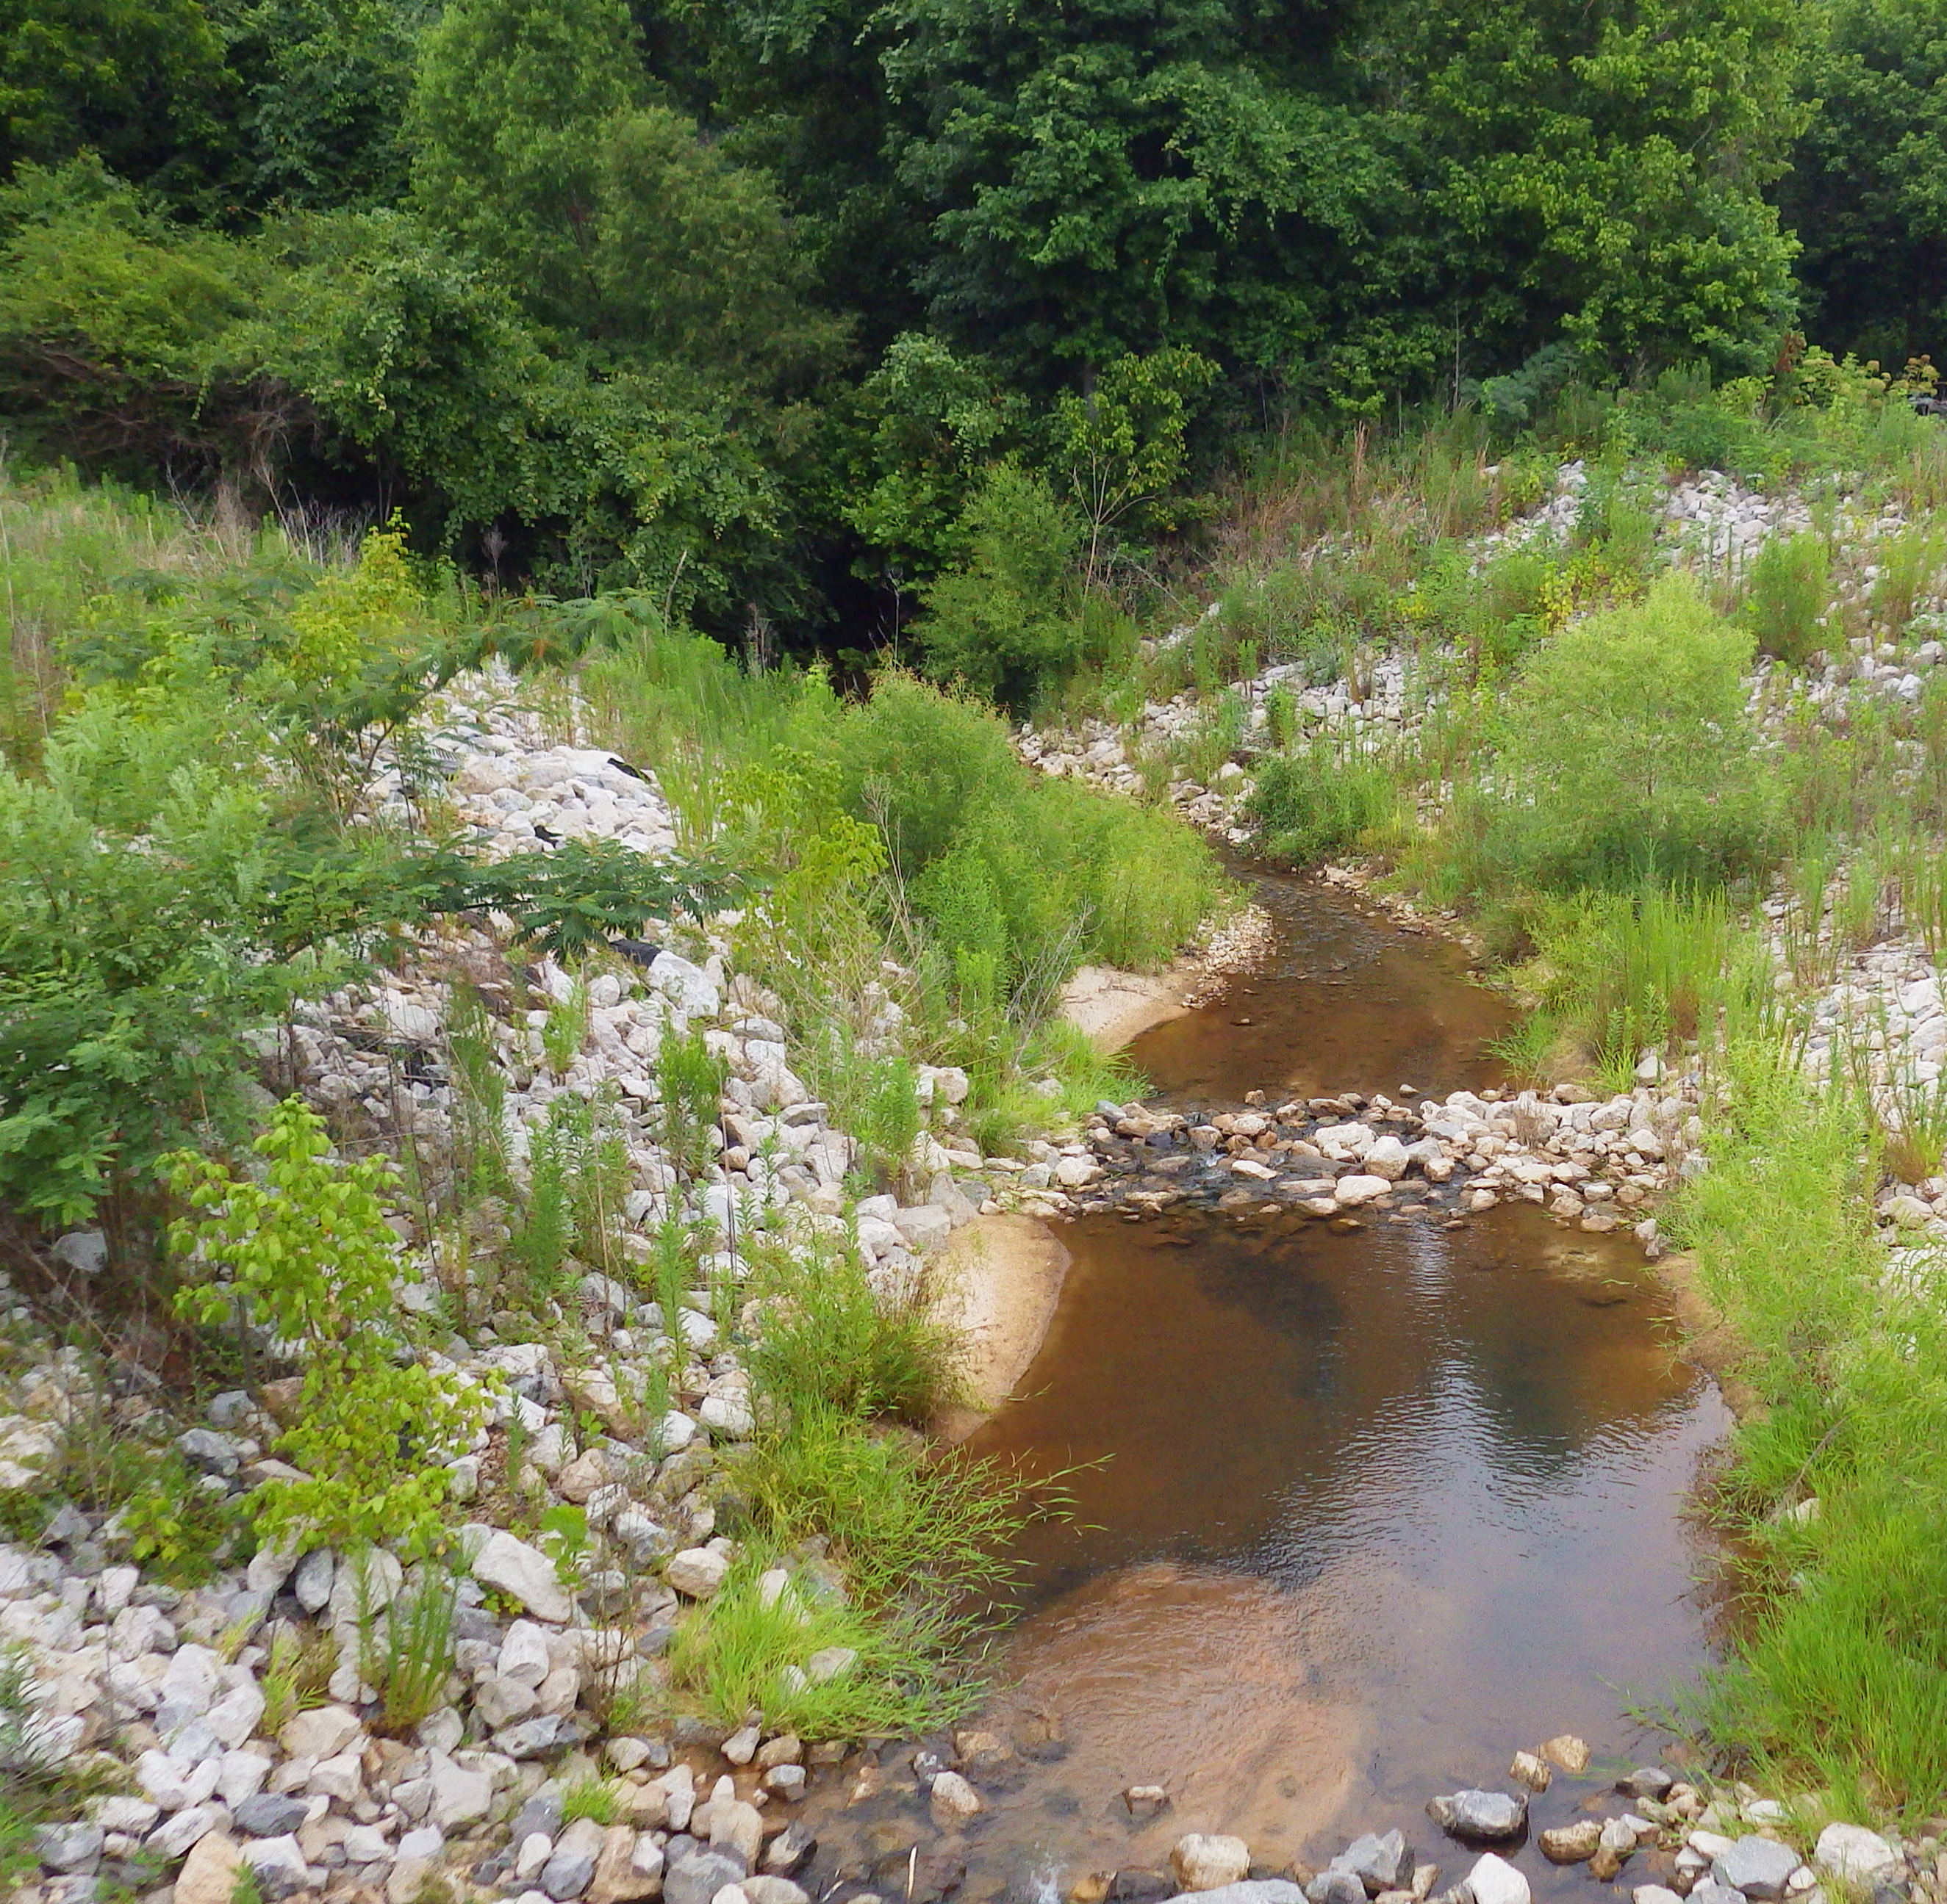
Recent Inspection Photos

Slide 39
QUESTIONS?

